Slide 1
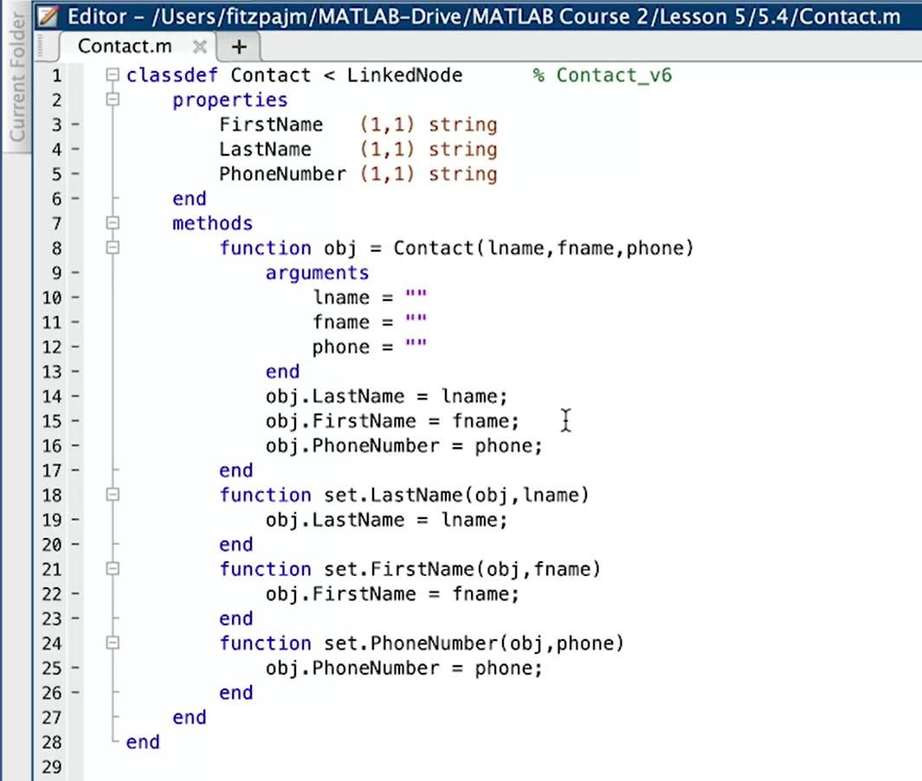
set. Şeklindeki ifadelerin outputlarını sildik çünkü Contact<LinkedNode yapınca onlara gerek kalmadı.
Ayrıca string kontrolleri arguments yöntemi ile halledildi.
Kodumuz artık daha temiz

Slide 2
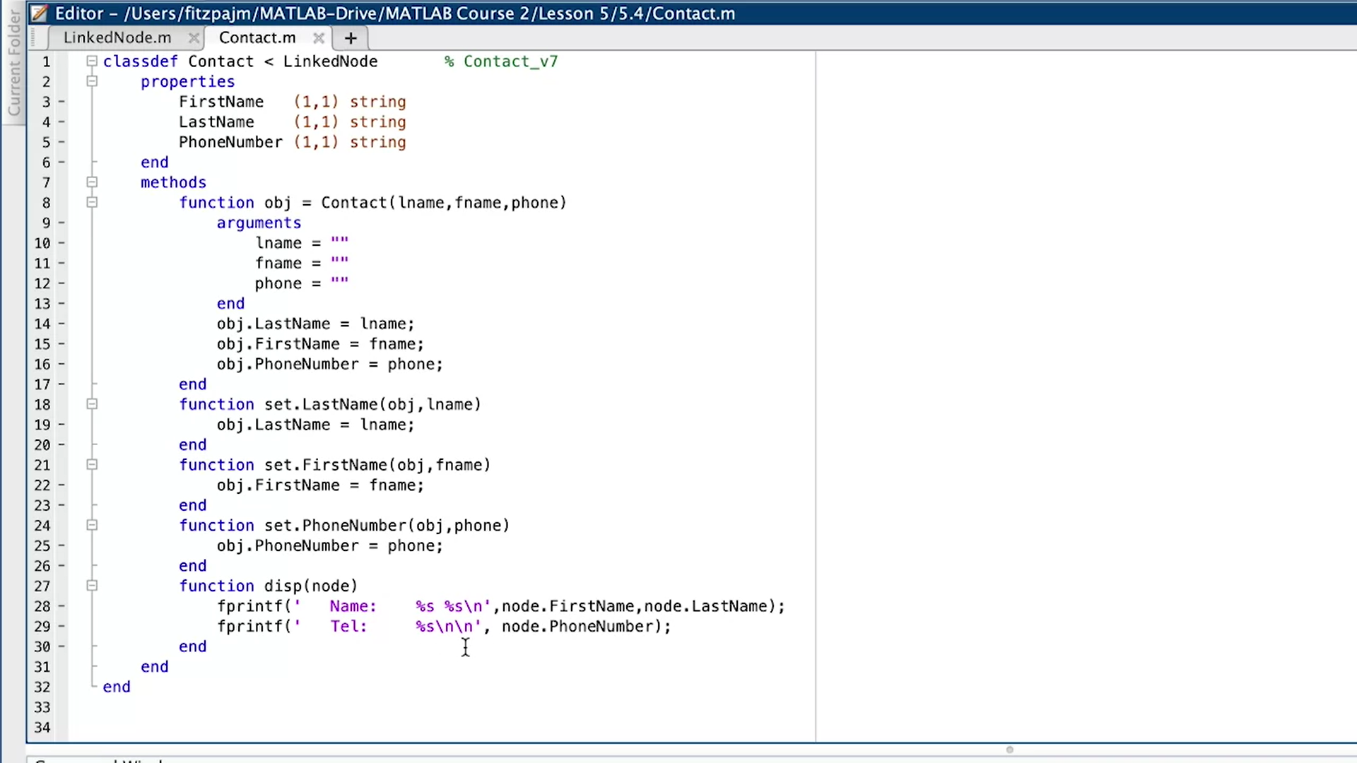
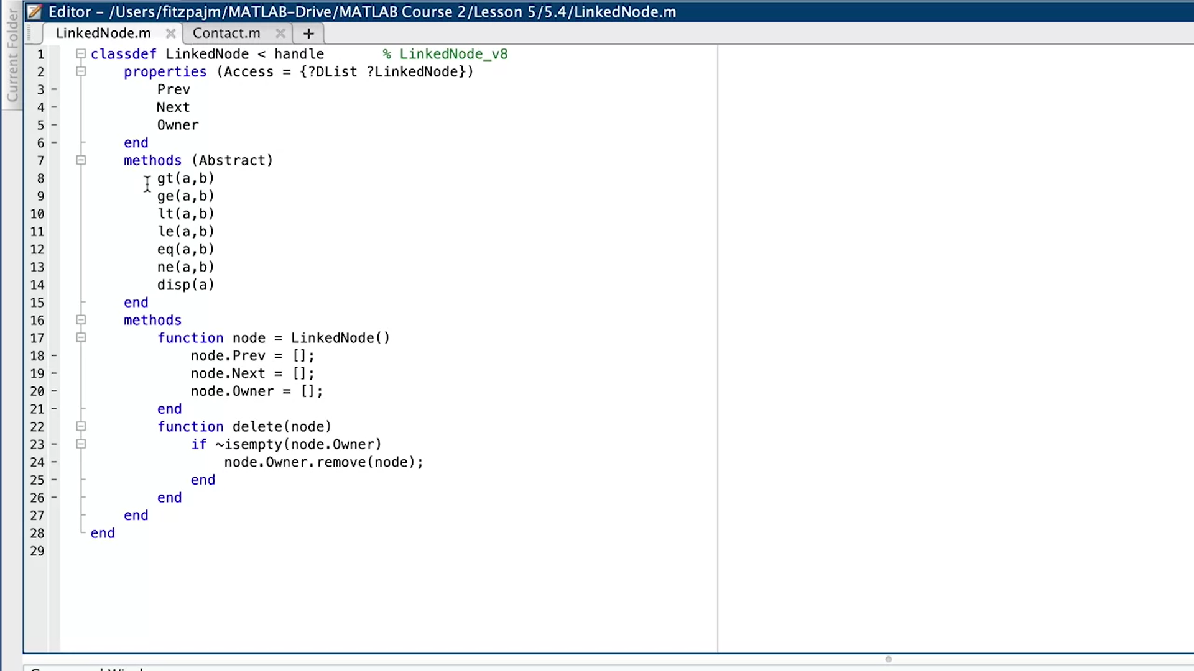

Slide 3
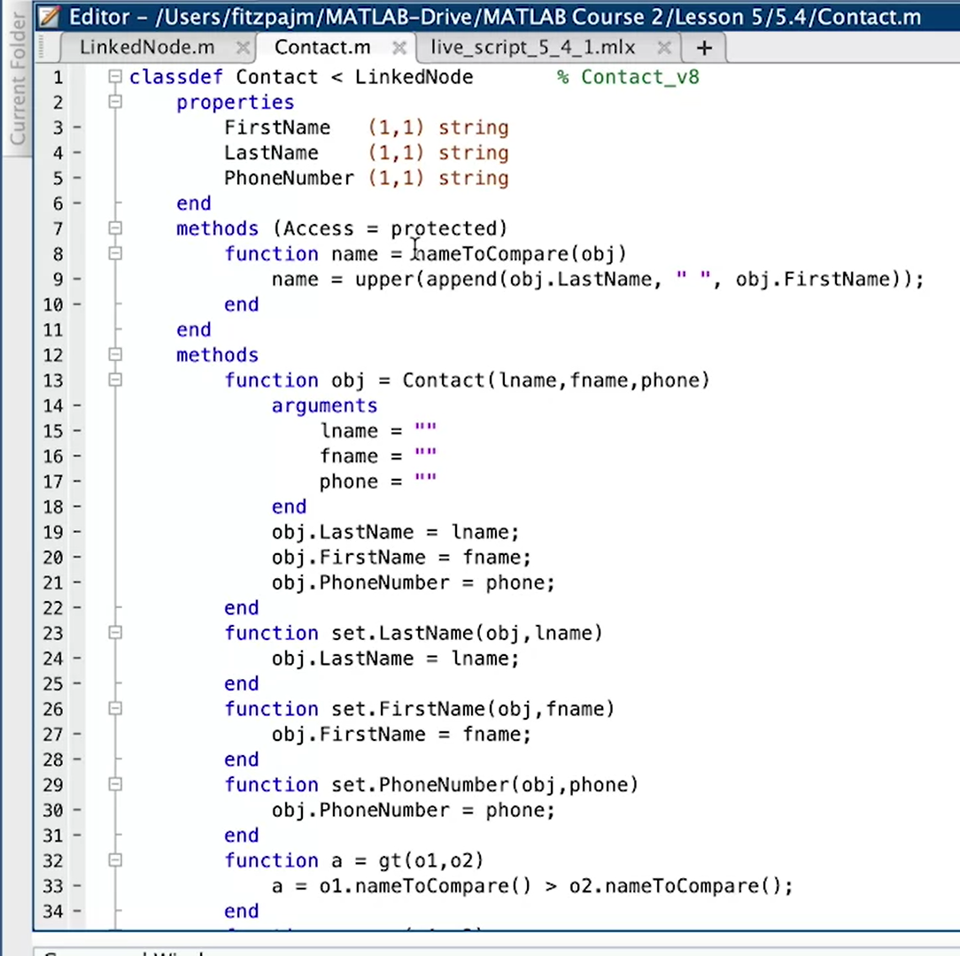
This method is just for internal use , that’s why we used Access=protected.
And we are using upper-case function to avoid issues if upper or lower .

Slide 4
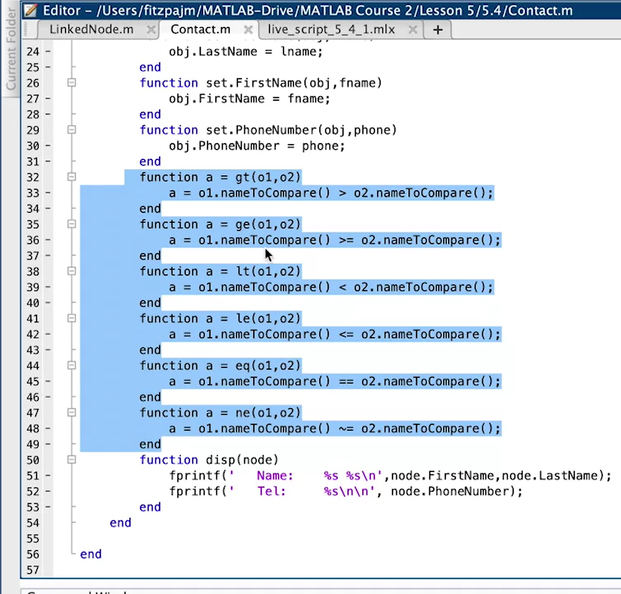
Since we put methods inside the LinkedNode , we should overload them.

Slide 5
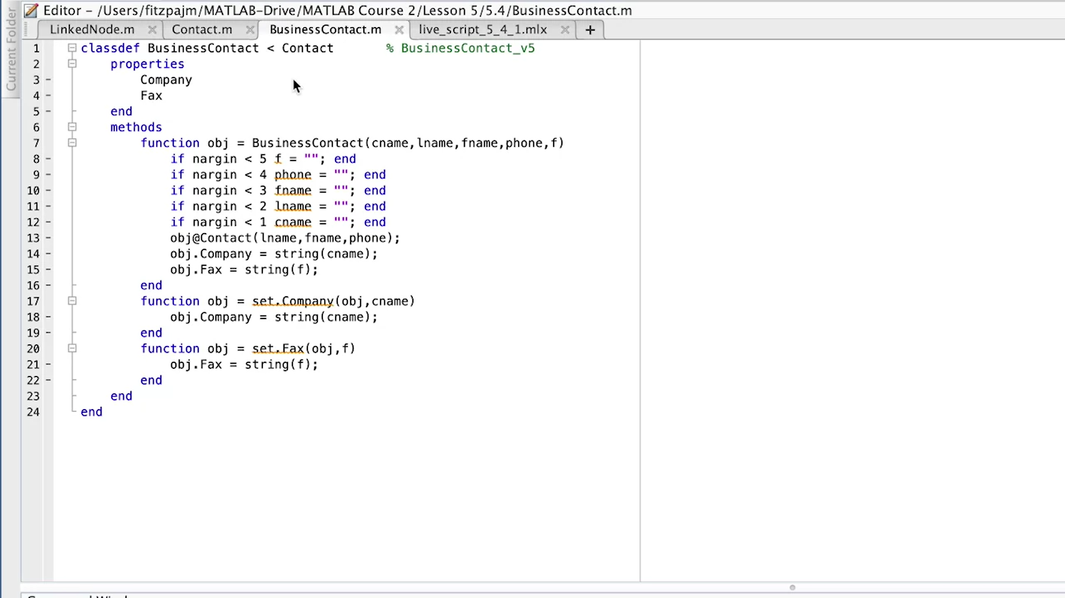
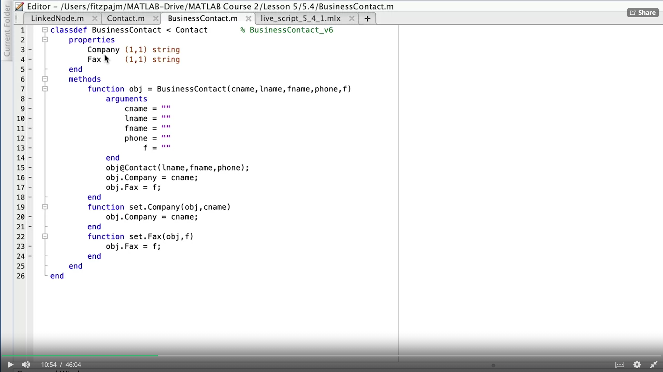
We didn’t touch this class for long time, lets play on it.
Nargin hundered times :’(

Slide 6
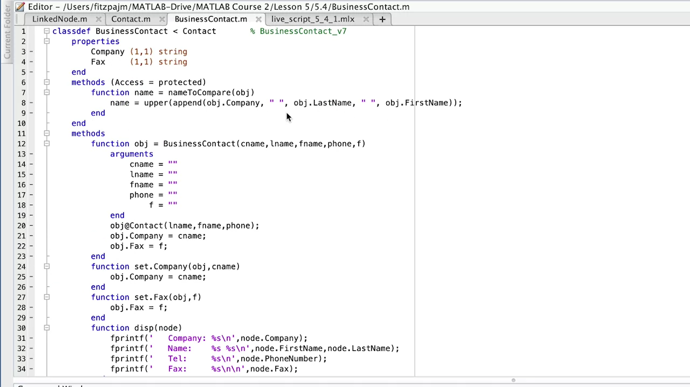
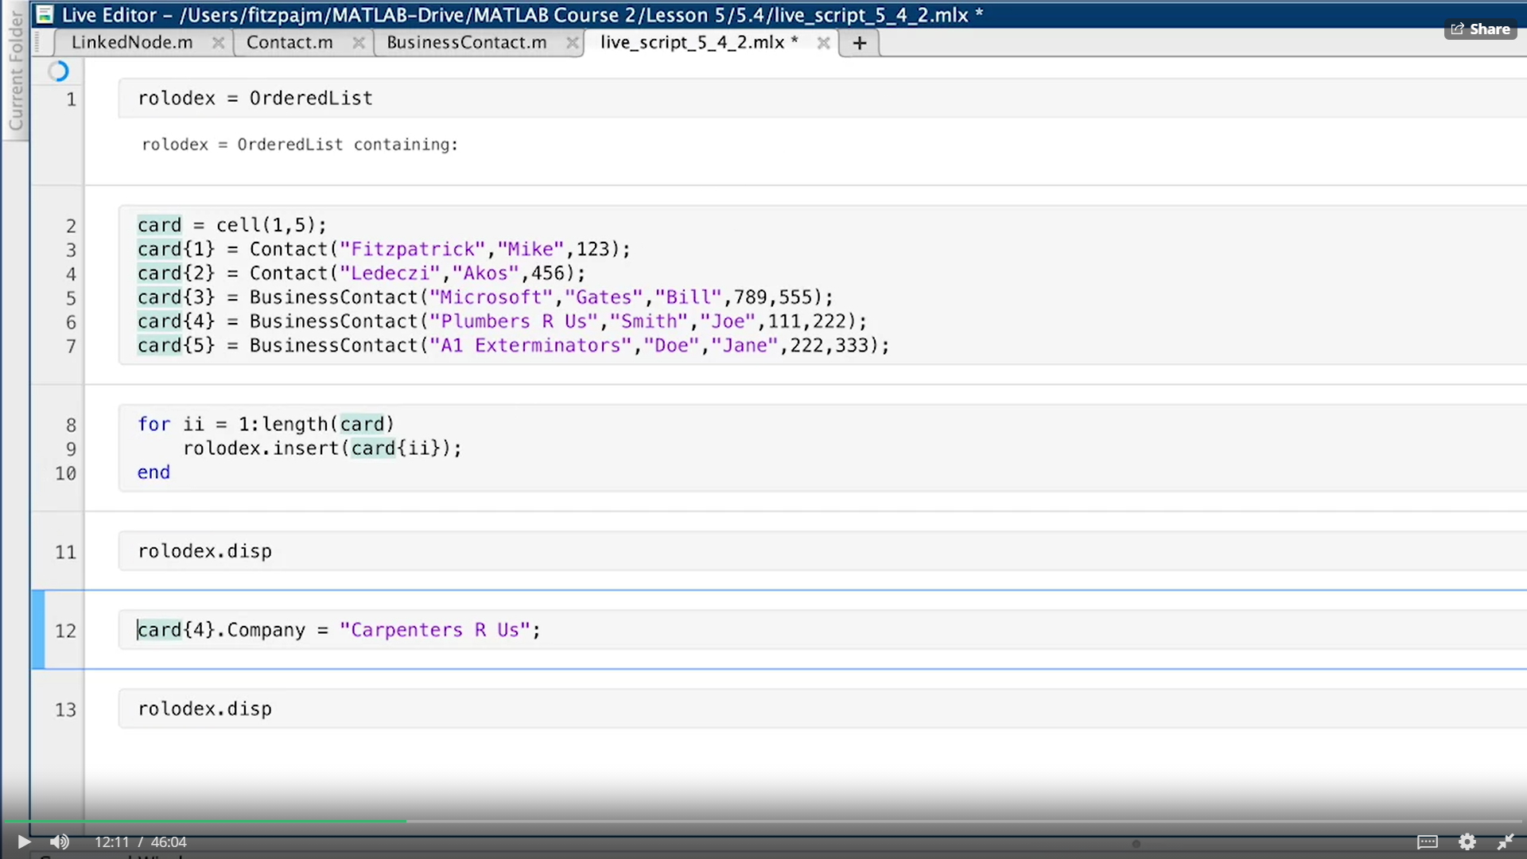
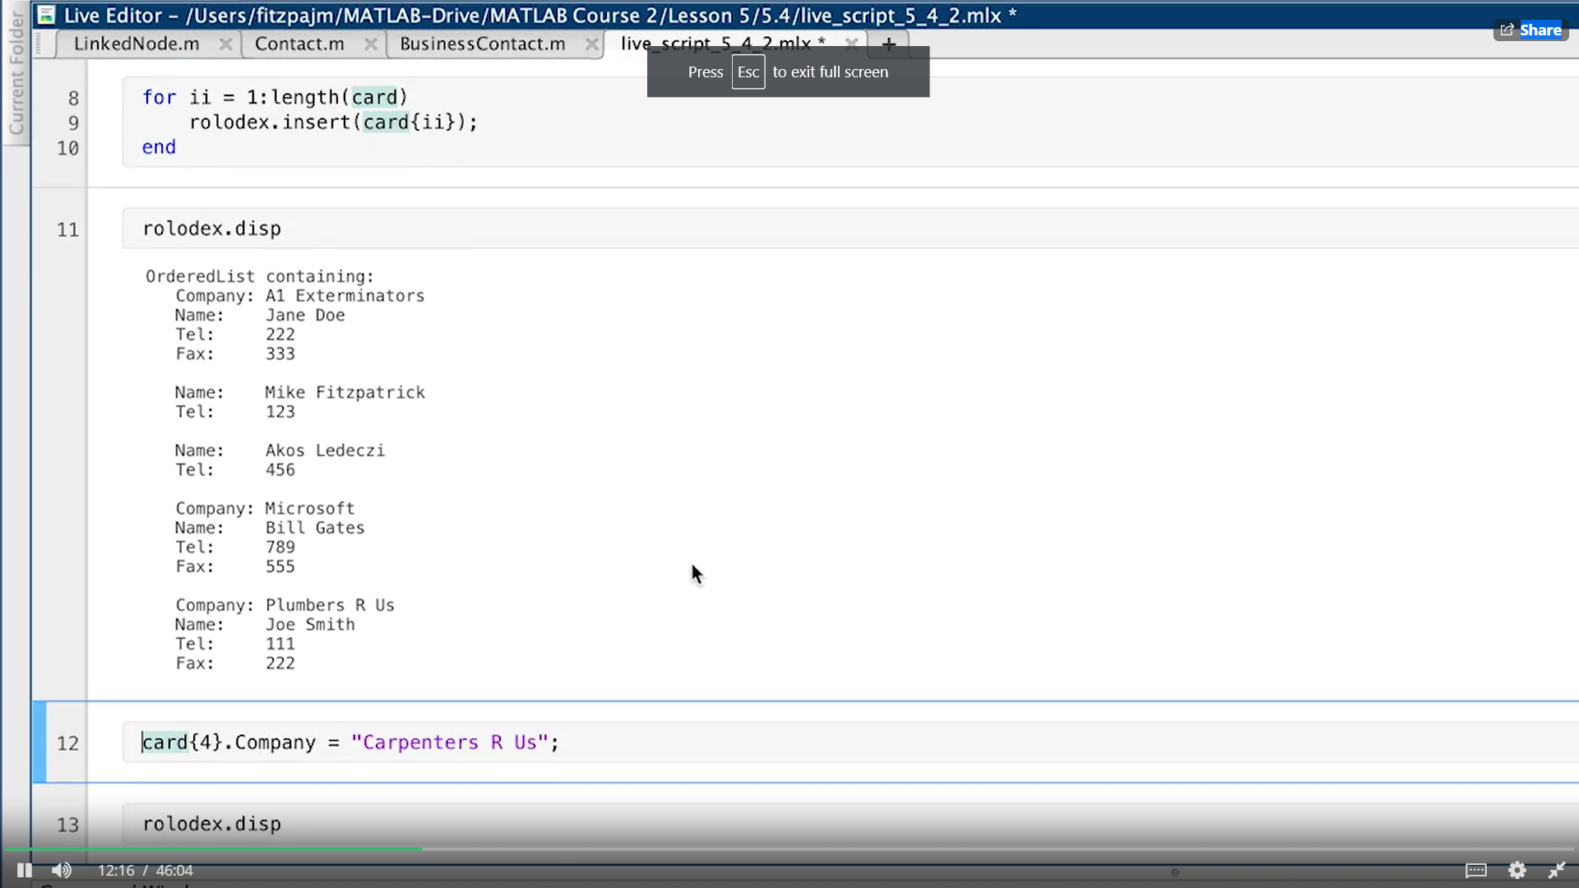
As seen here, we over-wrote disp method by including company name and fax number .
Then let’s examine:

Slide 7
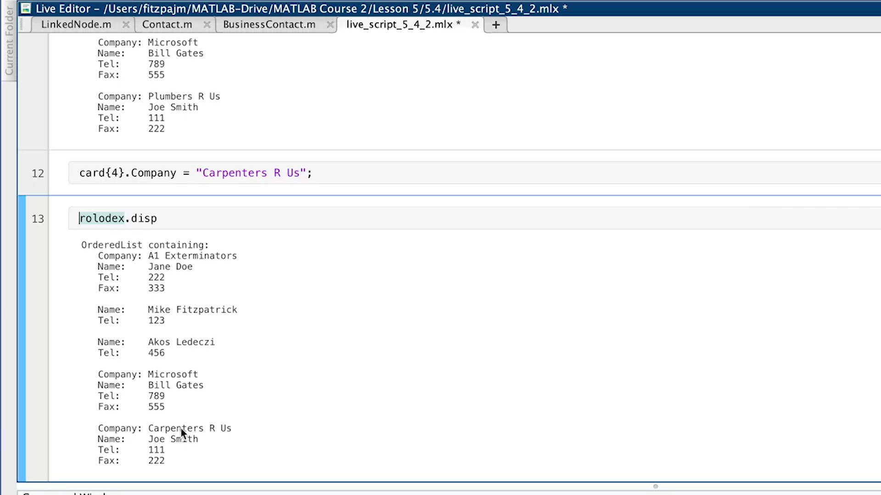
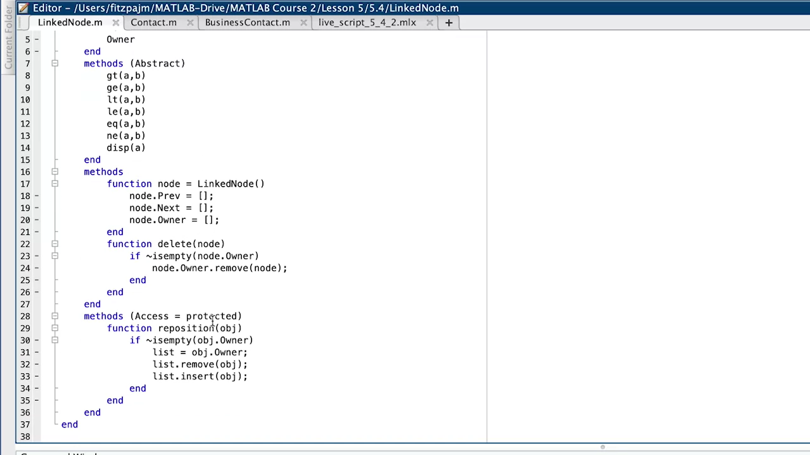
Let’s change one of the informations, and see if it will be sorted .
But indeed, it is not sorted because and we fixed:
And three set-access method required repositioning: CompanyName, Name and LastName.
Thus, we shall fix Contacct class and Business class but we fixed both of them in one, like doing change on LinkedNode. Because, LinkedNode is the superclass of them.
The code above is the attachment in LinkedNode.m file’s code. So this new method allows us to obtain sorted feature when doing something like card{4}.Company=“Carpenters R Us”;
But we also use this reposition function since we make it recently . This is in the next page of this slide.

Slide 8
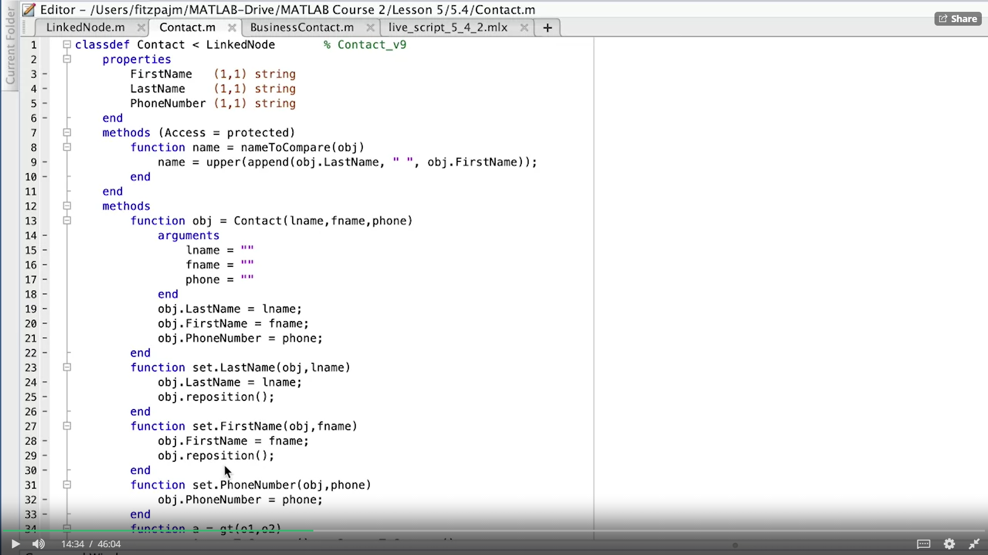
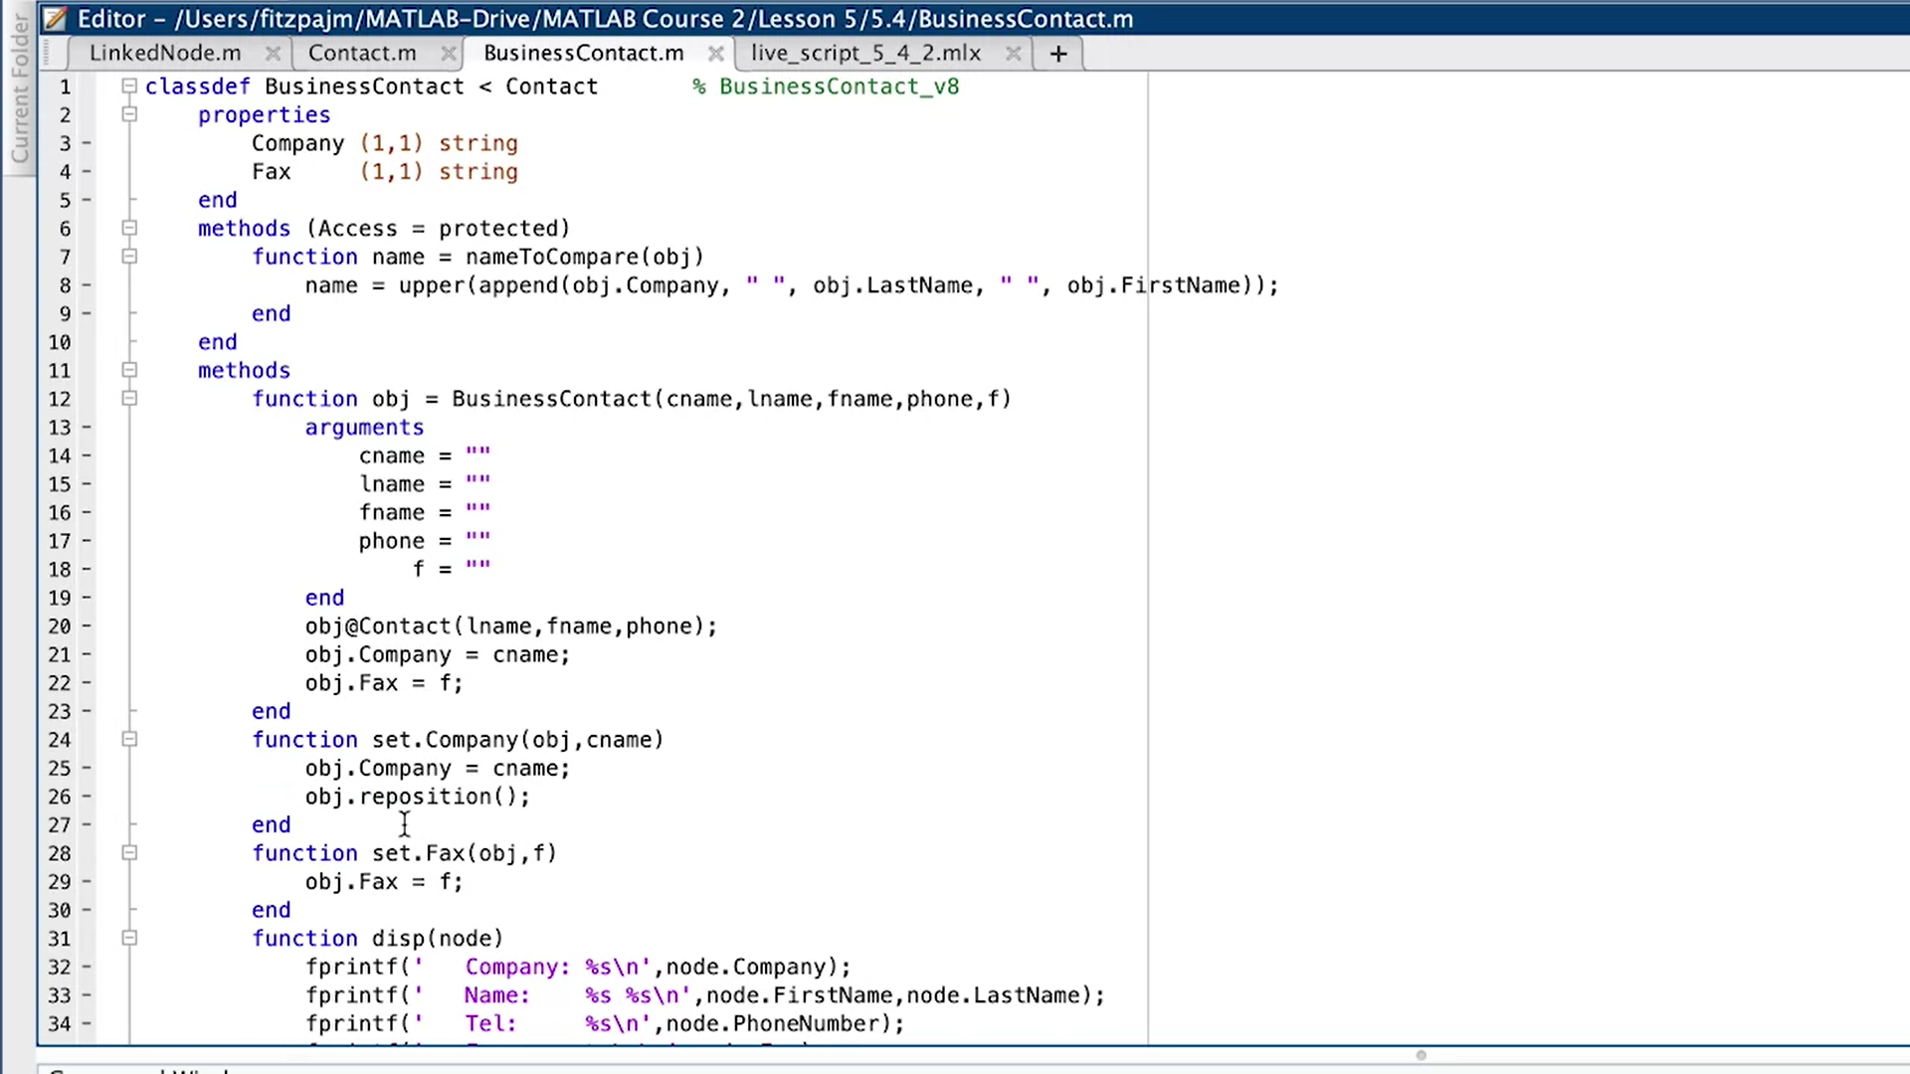

Slide 9
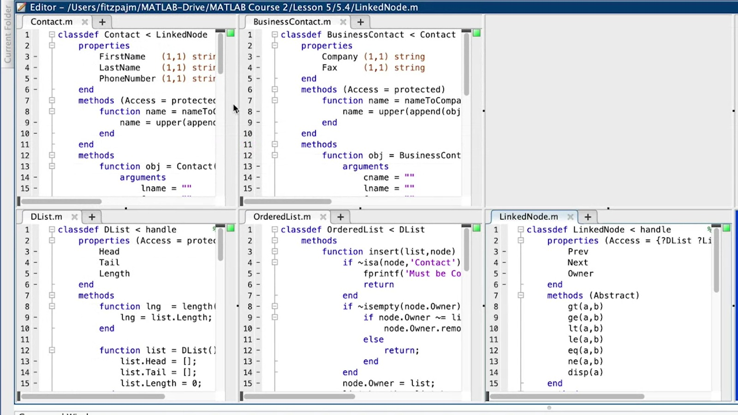
Parent class
Üstüme gelme benim :’)
Abstract class
Subclass

